Slide 1
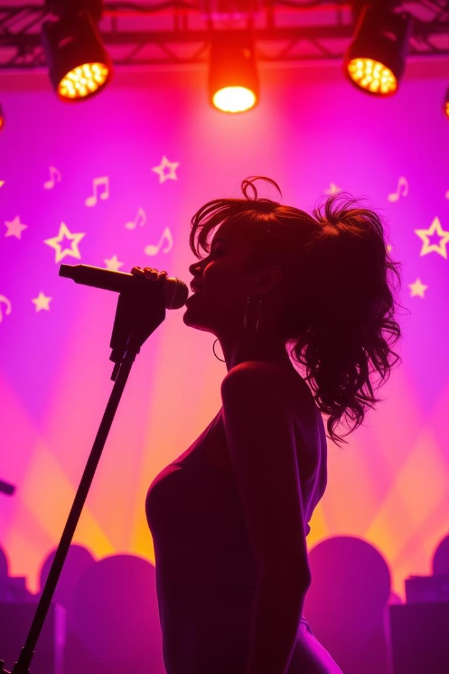
Zipf’s Law in Rihanna’s Lyrics
Presented by Team Rocket.
We explore language patterns and statistics in Rihanna’s lyrics.
Team Members:
Suryansh Gupta - 2024-B-08102006B
Shikhar Singh - 2024-B-03082006
Pranay Chitare - 2024-B-16102004
Nitin Sahu - 2024-B-03122005A

Slide 2
Project Background & Steps Followed
Objectives
Methodology
Discover language patterns and key themes
Clean text, remove punctuation, lowercase
Validate Zipf’s Law in lyrical data
2.Tokenize and count words
3.Apply Zipf’s Law analysis
Dataset & Tools
4.Visualize with word clouds and charts
Lyrics CSV including song titles, albums, release years
Python, pandas, matplotlib, numpy, collections, Google Colab

Slide 3
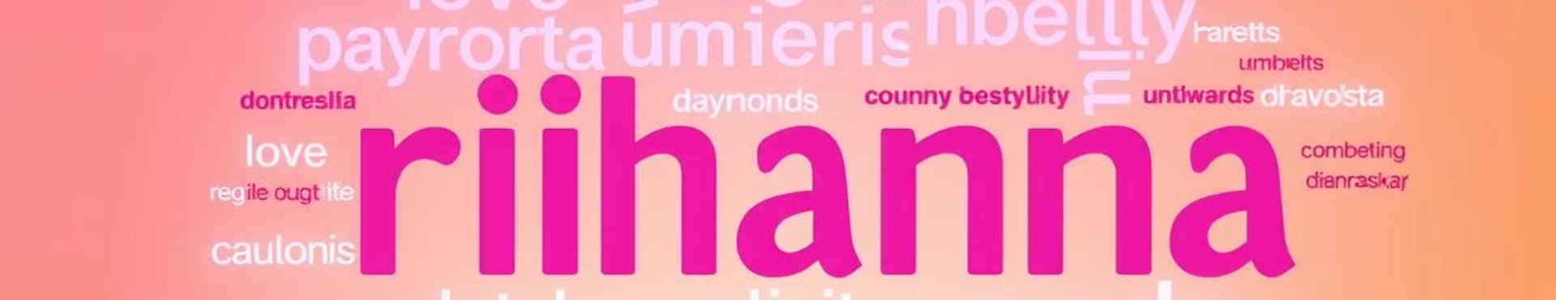


Exploratory Data Analysis & Key Insights
Frequent Words
Zipf’s Law Validation
Top 10 words reflect common themes like love and relationships.
Log-log plot confirms power-law distribution typical in natural language.

Slide 4


Team Member Contributions
Suryansh Gupta
Data cleaning, pipeline development, and project coordination.
Shikhar Singh
Created visualizations including plots and word clouds.
Pranay Chitare
Handled documentation, write-ups, and presentation layout design.
Nitin Sahu
Frequency analysis and development of Zipf’s Law logic.

Slide 5

Thank You! 🙏
Thank you for your time and attention. We hope you enjoyed our analysis.
Team Rocket
“Shine bright like a diamond...”

